Slide 1
Emergency Medical Service Database Management
MySQL database system (with ER Diagram) for a reporting of EMS treatments in combination with patient priorities, and medical expense.

Slide 2
Project Overview
Intro/Background
ER Diagram
Tables
Objectives
Data Reporting/Manipulations
Closing Thoughts

Slide 3
With SQL:
Manipulate Existing Data
Connect different information
Draw conclusions

Slide 4
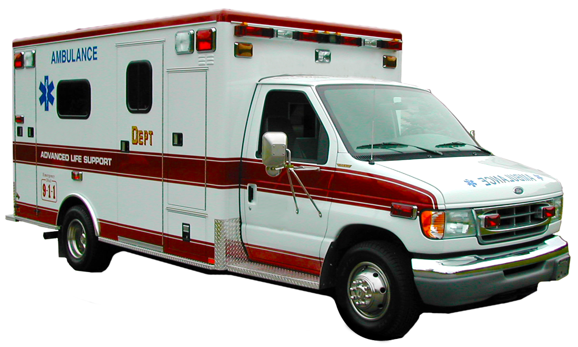
Background
EMT Rescue Squads respond to emergency calls.
They are prepped to handle nearly all emergency situations
In this case: I have assigned each rescue squad with one type of call
Once on scene work is done the ambulance goes to the Hospital
In the hospital EMT briefs the emergency room nurse/doctor about the situation and if ALS (Advanced Life Support) Assisted on the patient before arrival
Now it is the responsibility of the hospital to take care of the new patient
Obviously, hospitals are equipped with Doctors trained in all manner of emergency medicine
In my case: I have assigned each Hospital/Doctor with one type of specialty

Slide 5
Name
Pat_ID
EMP_ID
Squad Name
Sqd_ID
Address
Hos_ID
Name
Age
Gender
Hospital
Rescue Squad
Patient
Type
Address
Squad No.
Squad Address
Pat_ID
Name
Treatment_ID
1:M EMT help Many Patients
Treatment
1:M Squad Employs Many
Doc_ID
1:M Hospitals hire many Drs
1:1 Each Unit responds to Different types of calls
1:M 1 Dr. sees many Pats
Doc_ID
EMP_ID
Specialty
Emp Name
Name
Call_ID
Doctors
Rank
Squad Employee
Call Type
Name
ALS Assist Y/N
Hos_ID
Sqd_ID
Priority Color
Sqd_ID
Salary
Salary

Slide 6
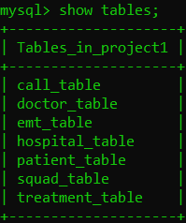
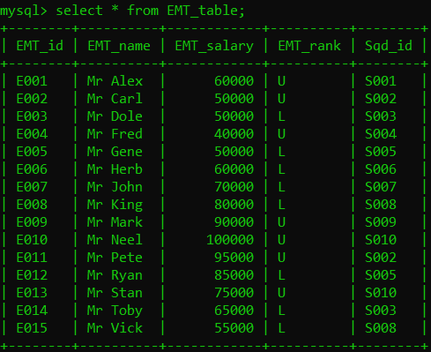
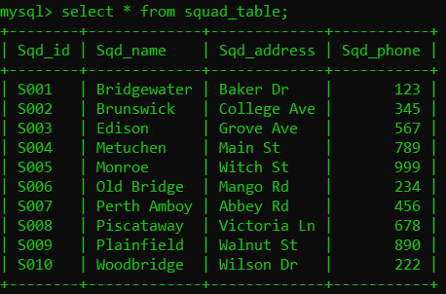
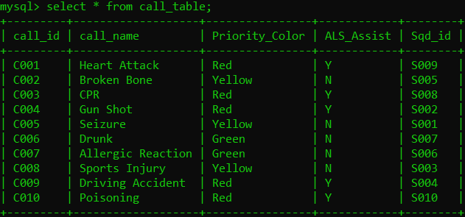
Tables

Slide 7
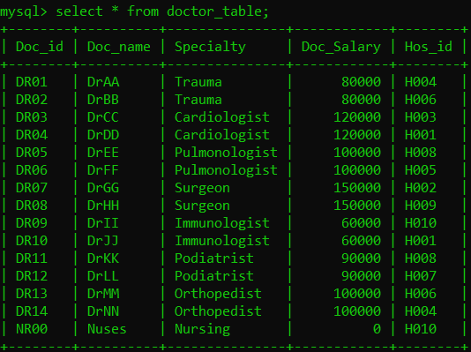
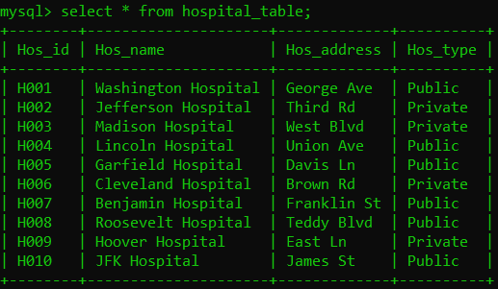
Tables

Slide 8
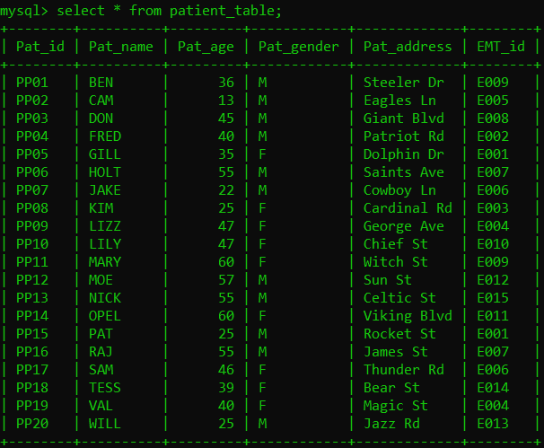
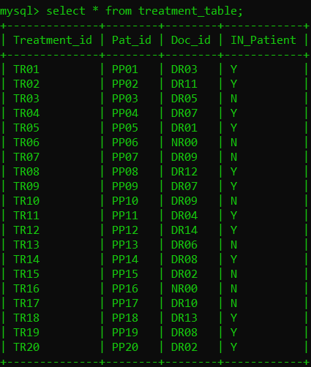
Tables

Slide 9

Objectives
Patient Based (PB):
Patients in each Priority Color / if they had ALS (Advanced Life Support)
Total payment for each patient
How many males had red level cases and were in-patient?
Average age of everyone who had surgery
Hospital Based (HB):
Which Hospital did each Patient go to?
How many patients went to private hospitals?
Find patient based on clue from their name
Rescue Squad Based (RB):
Collect EMTs based on their area of expertise
Correct a patient info in the table
Deleting Upper Level EMTs to see who requires more training (SAVE POINT).
Delete from master table to see its effects

Slide 10

Reporting/Manipulating Data

Slide 11
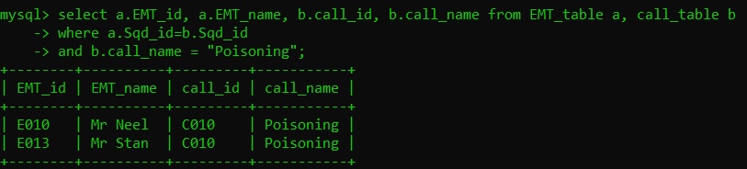
Reporting Data
RB
Collect EMTs who treat Poisoning.

Slide 12
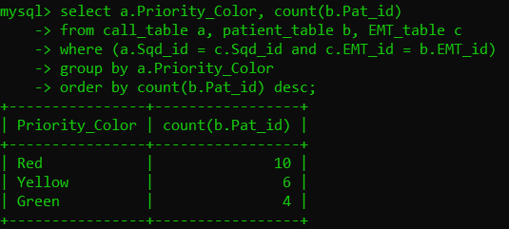
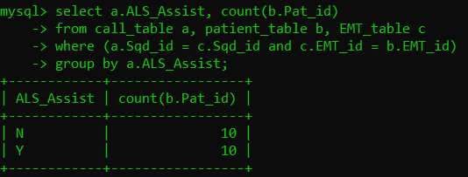
Reporting Data
PB
How many patients are there in each Priority Color?
How many patients are there who received ALS (Advanced Life Support) Assistance?

Slide 13
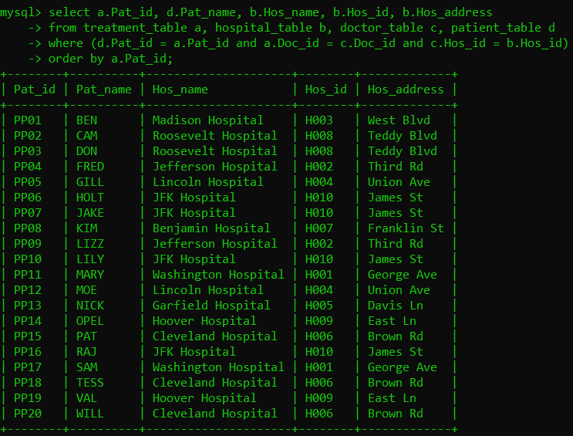
Reporting Data
HB
Which Hospital did each
patient go to?

Slide 14
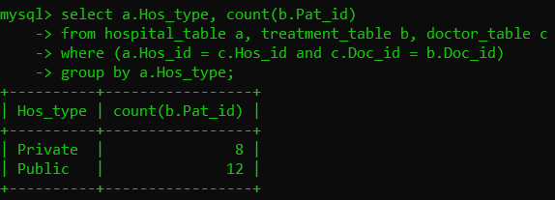
Reporting Data
HB
How many went to a Private or Public Hospital?

Slide 15
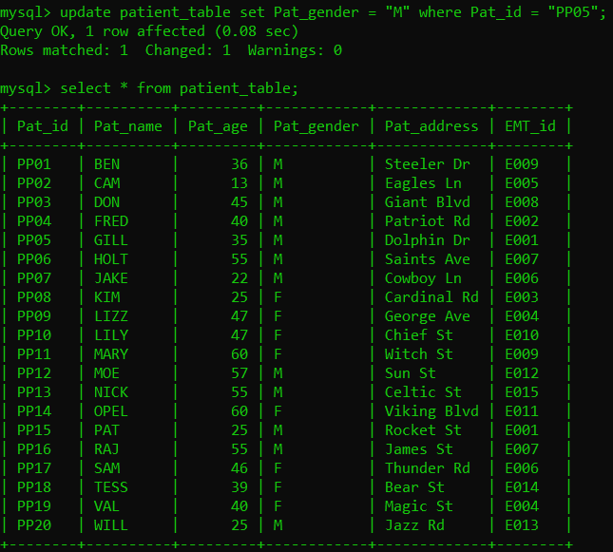
Manipulating Data
RB
Correct the Gender of
Patient Named: Gill.
From F to M.

Slide 16
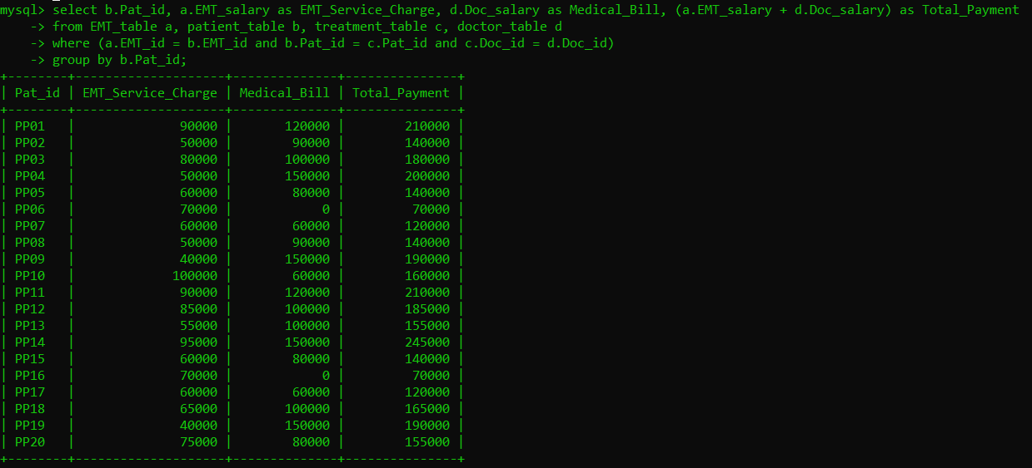
Reporting Data
PB
How much does each patient owe in medical expense?

Slide 17
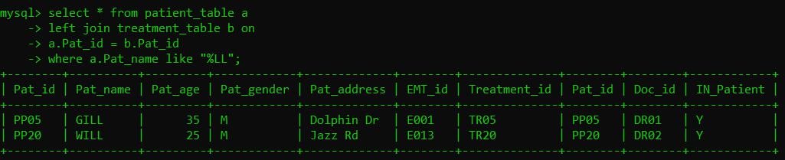
Reporting Data
HB
Searching for a patient: Find FULL PATIENT DETAIL about patients with name ending in “LL”

Slide 18
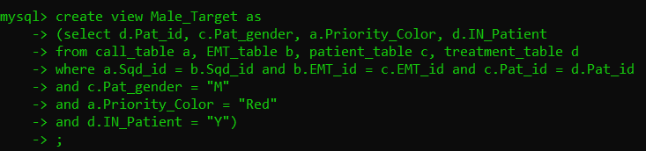
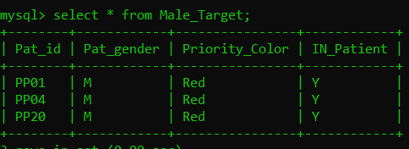
Reporting Data
PB
Collect Males who had a Priority Red case AND had In-Patient status

Slide 19
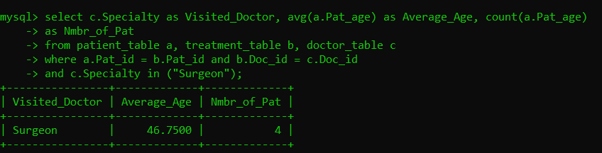
Reporting Data
PB
Average Age of everyone a Surgeon operated on.

Slide 20
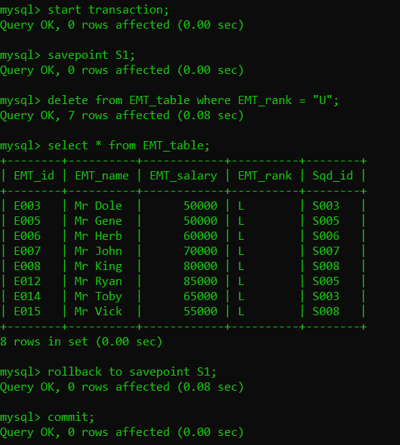
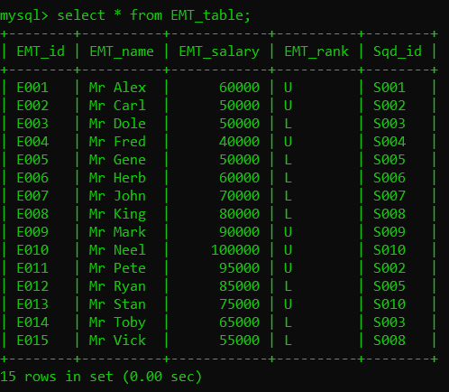
Reporting Data
RB
Get a list of EMTs who need to be trained.
Delete Upper Ranks to gather only Lower.

Slide 21
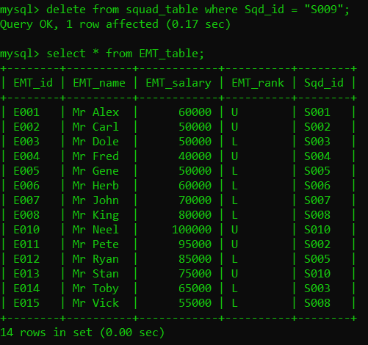
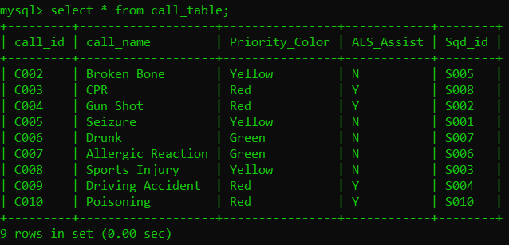


Manipulating Data
Deleting from the Master Table
No more Heart Attack calls because the Rescue Squad responsible for treating it is gone
Mr. Mark is gone from the new table

Slide 22
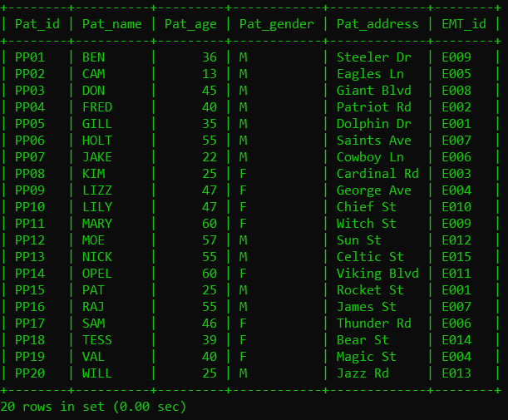
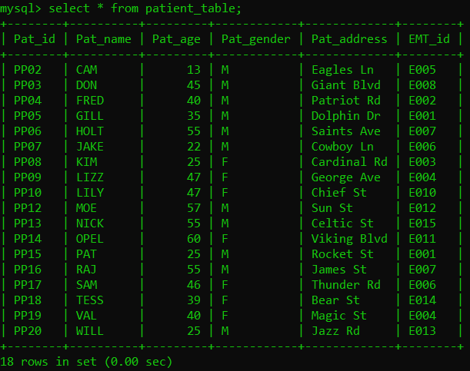
Manipulating Data
Deleting from the Master Table (cont)
Mr. Mark (E009) is gone
So the patients he treated are gone from the record as well

Slide 23
Concluding Thoughts
Able to Manipulate Existing Data
Connect different tables together and draw specific information
Draw conclusions which can help develop infrastructures

